Slide 1
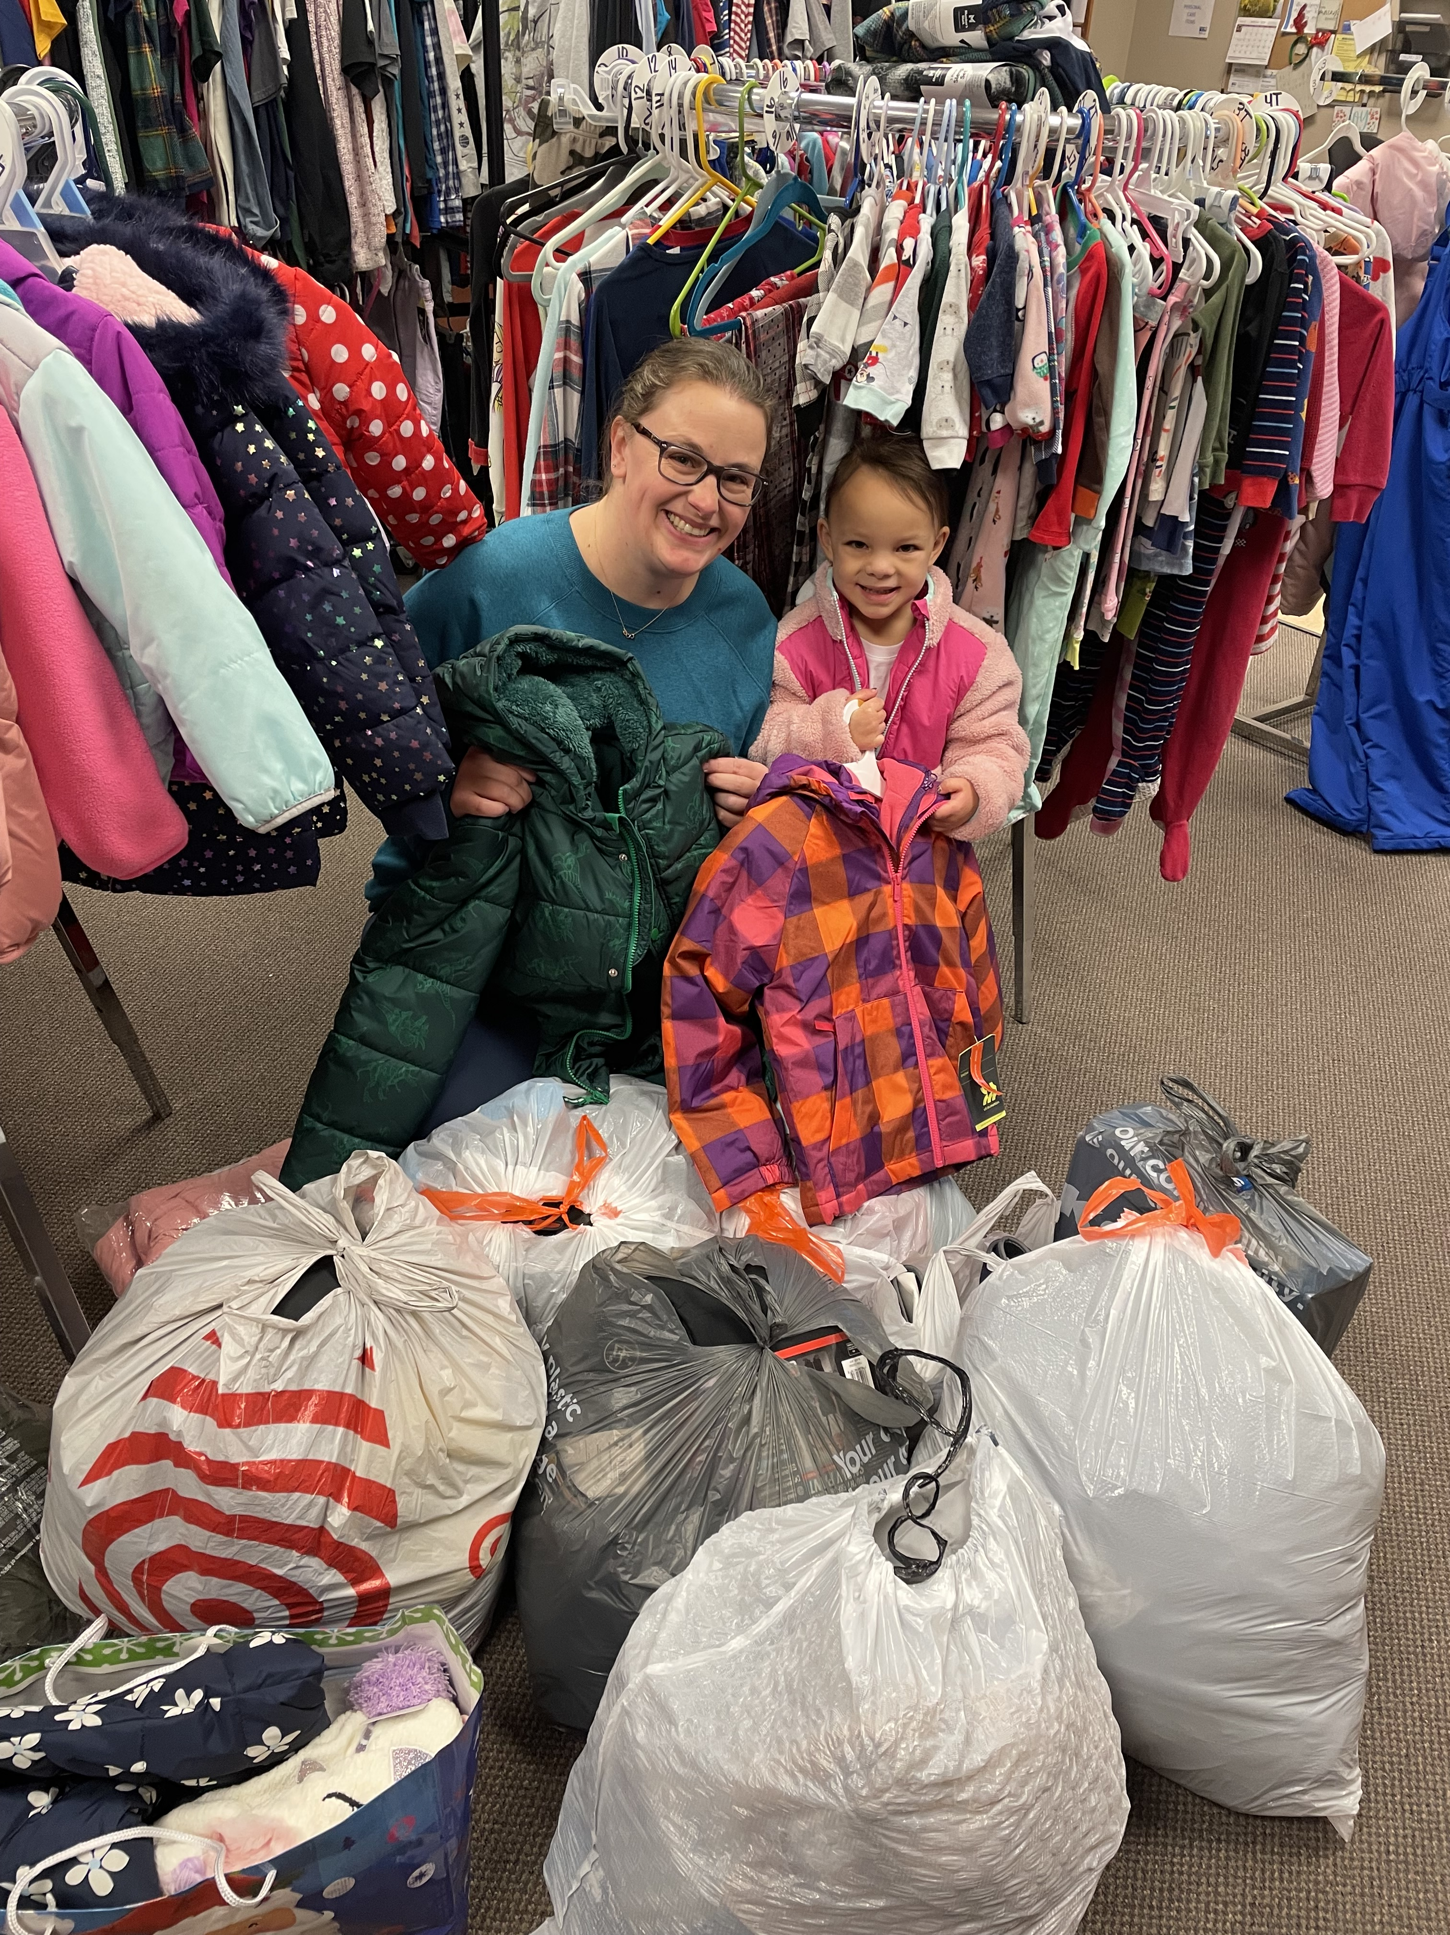
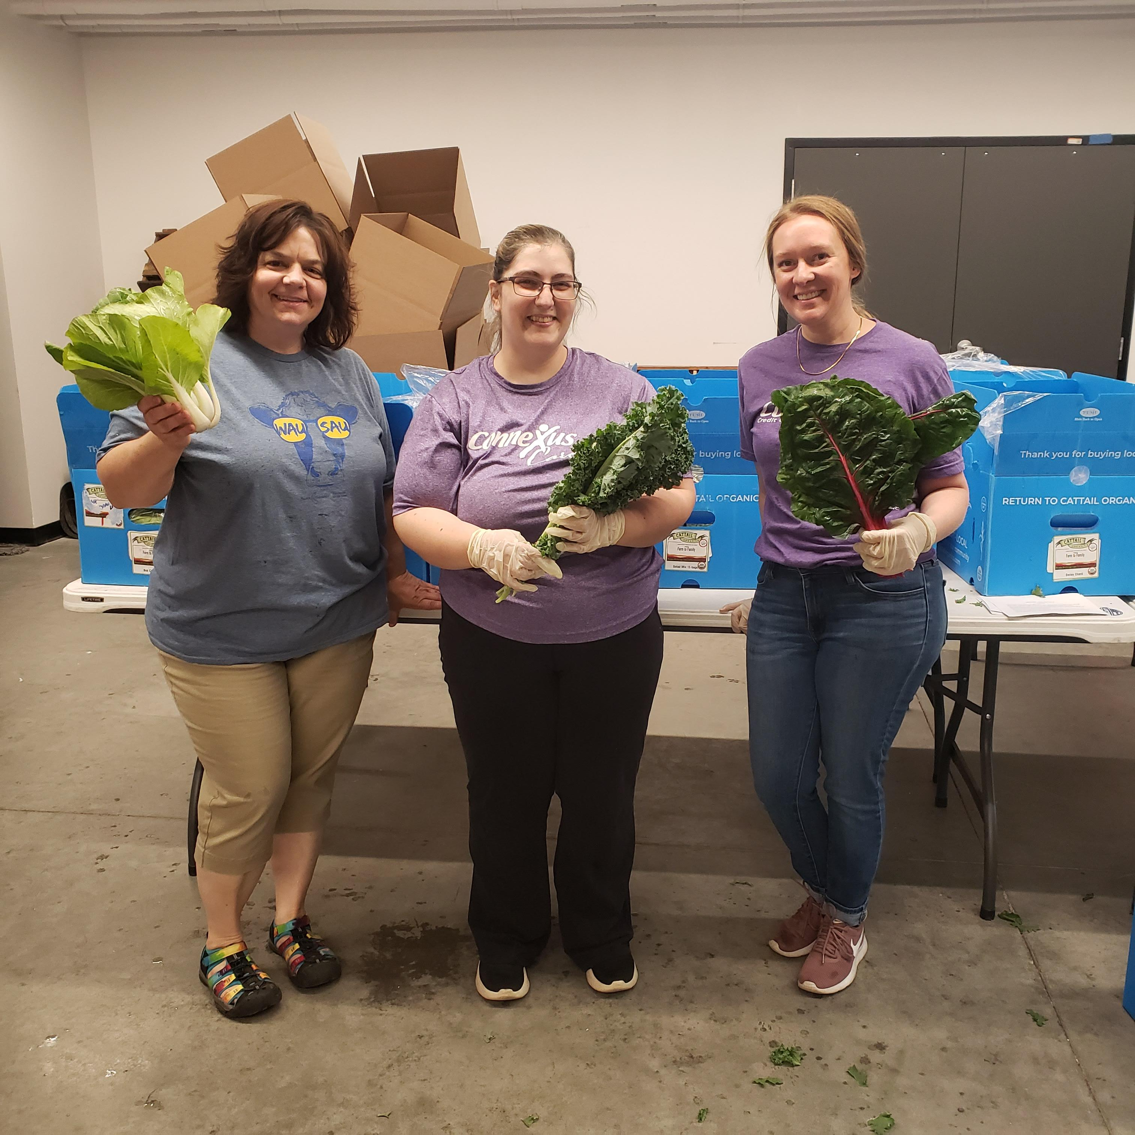
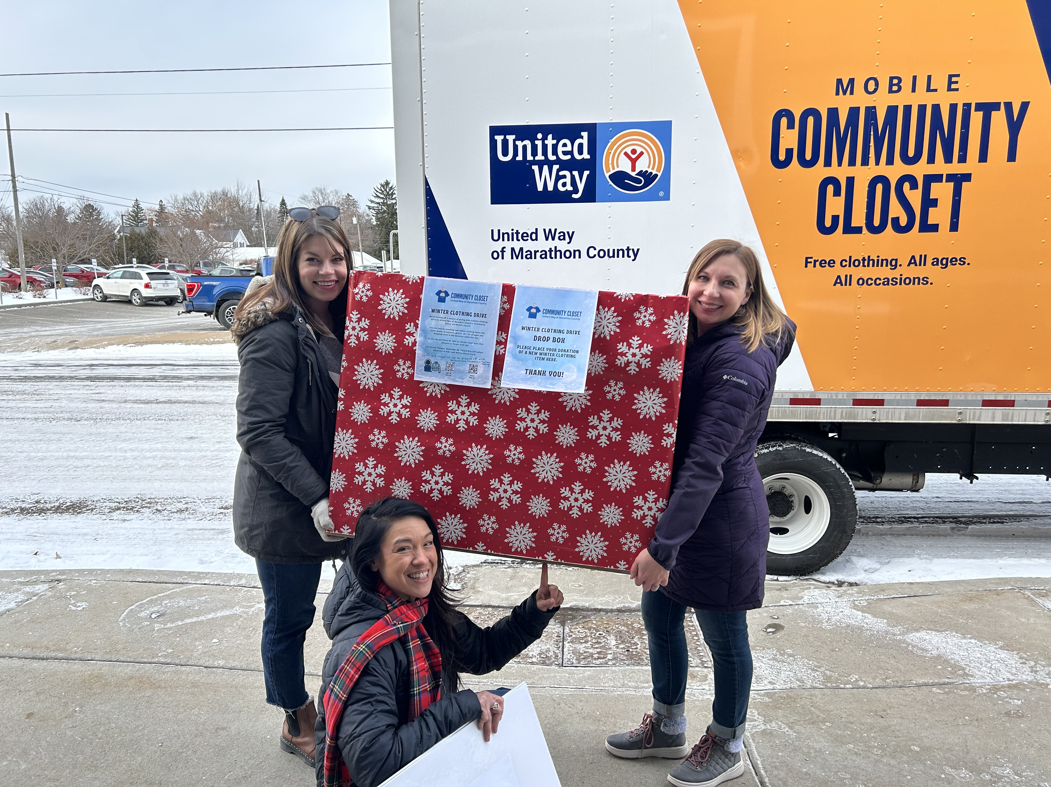
United Way of Marathon County

Slide 2
New Mission and Bold Goal
Lift 10,000 Community Members to Financial Stability by 2033.

Slide 3
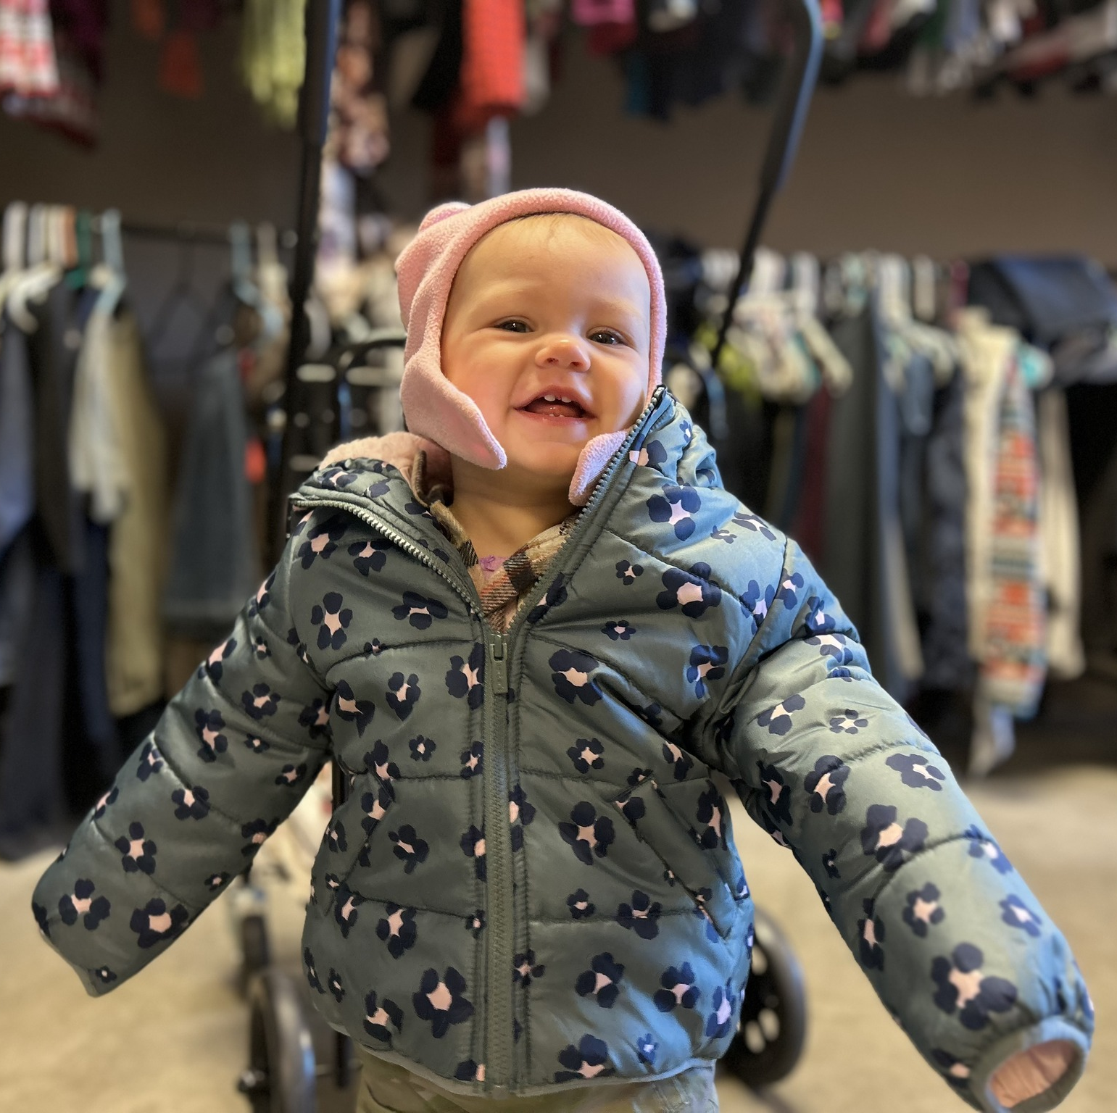
Progress Towards the Bold Goal
In the first 6 months of 2024:
8,843 Individuals Served
33% of those served are achieving stability or higher.
2,903 Individuals Lifted to Financial Stability
3,312 individuals referred to other services

Slide 4
To achieve this mission, United Way:
Evaluates – we review data, monitor trends, and stay informed about local issues. This information helps us set priorities to guide our investments and initiatives.
Invests – we strategically invest donor dollars in programs that help us achieve our bold goals.
Convenes – we bring together people from businesses, non-profits, schools, government, and the faith community to create a greater collective impact.
Mobilizes – we recruit, promote, and support volunteers within the community.
Connects – we connect people to services and resources, through United Way’s 211.

Slide 5
Who is Alice?
Asset Limited Income Constrained Employed
42% of the population of the City of Wausau falls within ALICE.
Parents working two or three jobs but struggling to pay the bills.
Retirees living on a fixed income and the price of living continues to rise.
Alice is your server, nursing assistant, mail carrier, cashier etc.

Slide 6
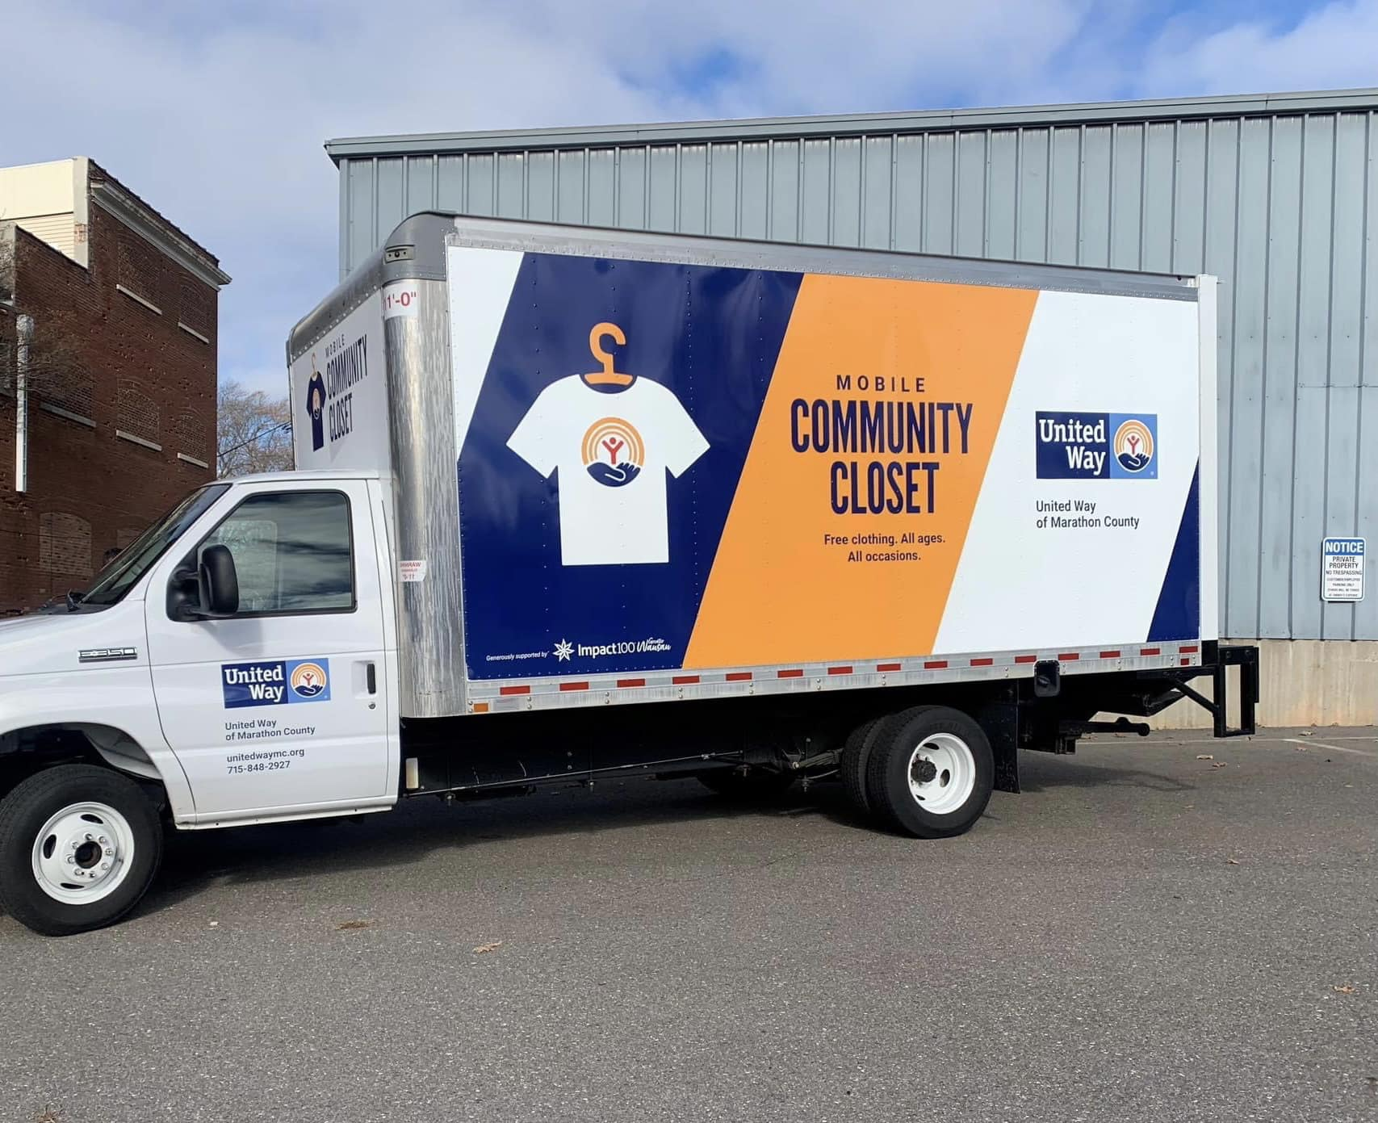
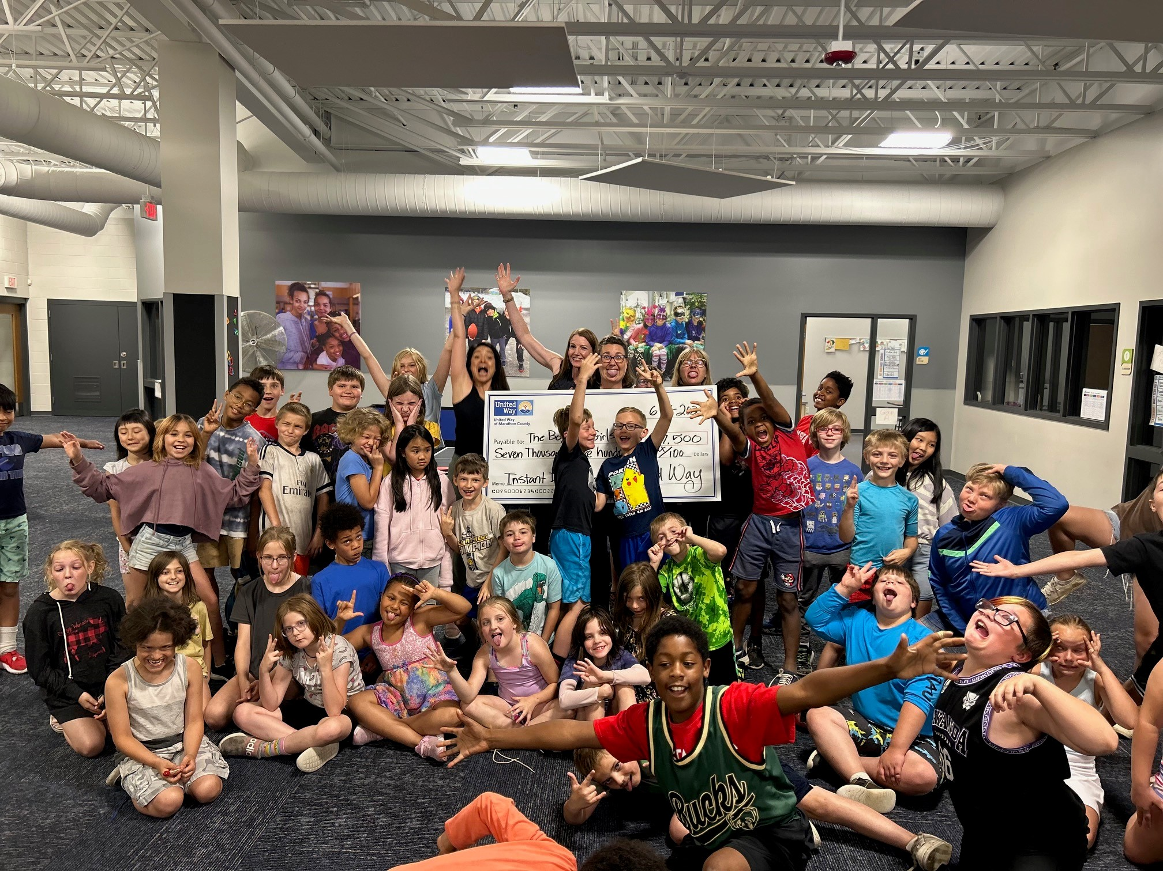
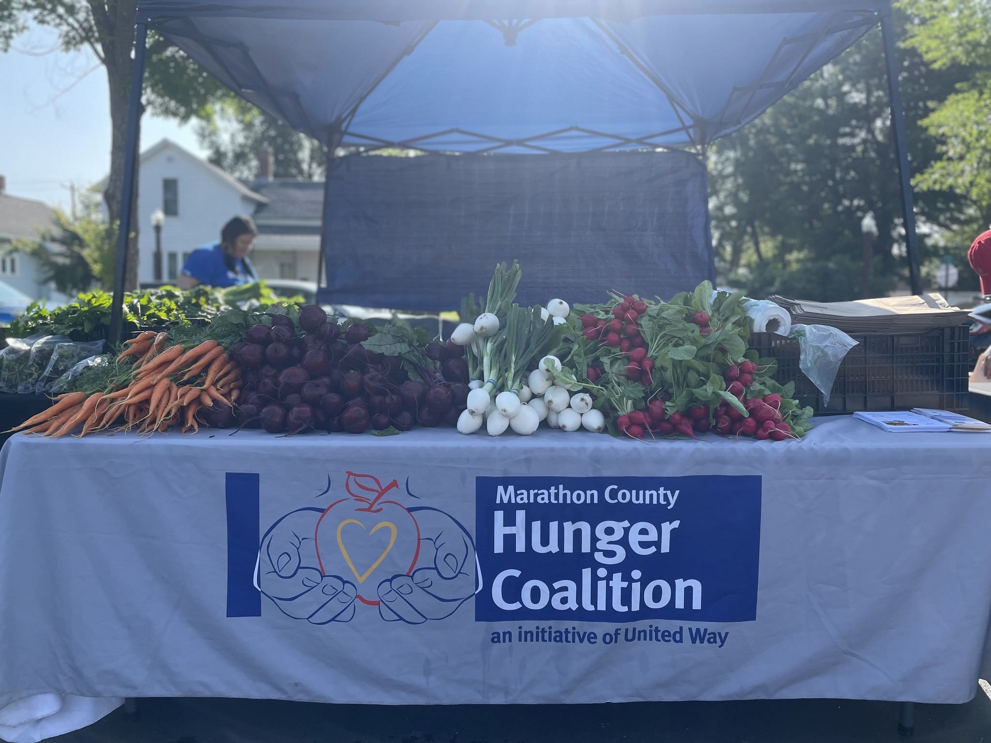
2023 Impact
The programs funded in this cycle were focused on education, financial stability, and health to ensure every child and
person has a chance for success. A total of 36 grants were awarded to 24 nonprofits amounting to $1.6 million dollars.
100 boxes of fresh produce were distributed every week to community members who did not have access to healthy foods.
Launched the Mobile Community Closet to bring free clothing to families and individuals across the county.

Slide 7
The Marathon County Hunger Coalition
The Coalition works with numerous pantries from around the county to provide nutritious food throughout the year.
Community Supported Agriculture (CSA) boxes bought from local farmers. Red Door Family Farms and Cattail Organics bring nutritious food to tables in our area, connecting those in need with fresh, locally-grown produce. Partnering with local farms and offering fresh, locally grown produce allows 100% of donated funds to stay in the community.

Slide 8
In 2023, United Way’s 211 answered 4,796 requests for help from Marathon County residents and provided 10,854 referrals to community resources.

Slide 9
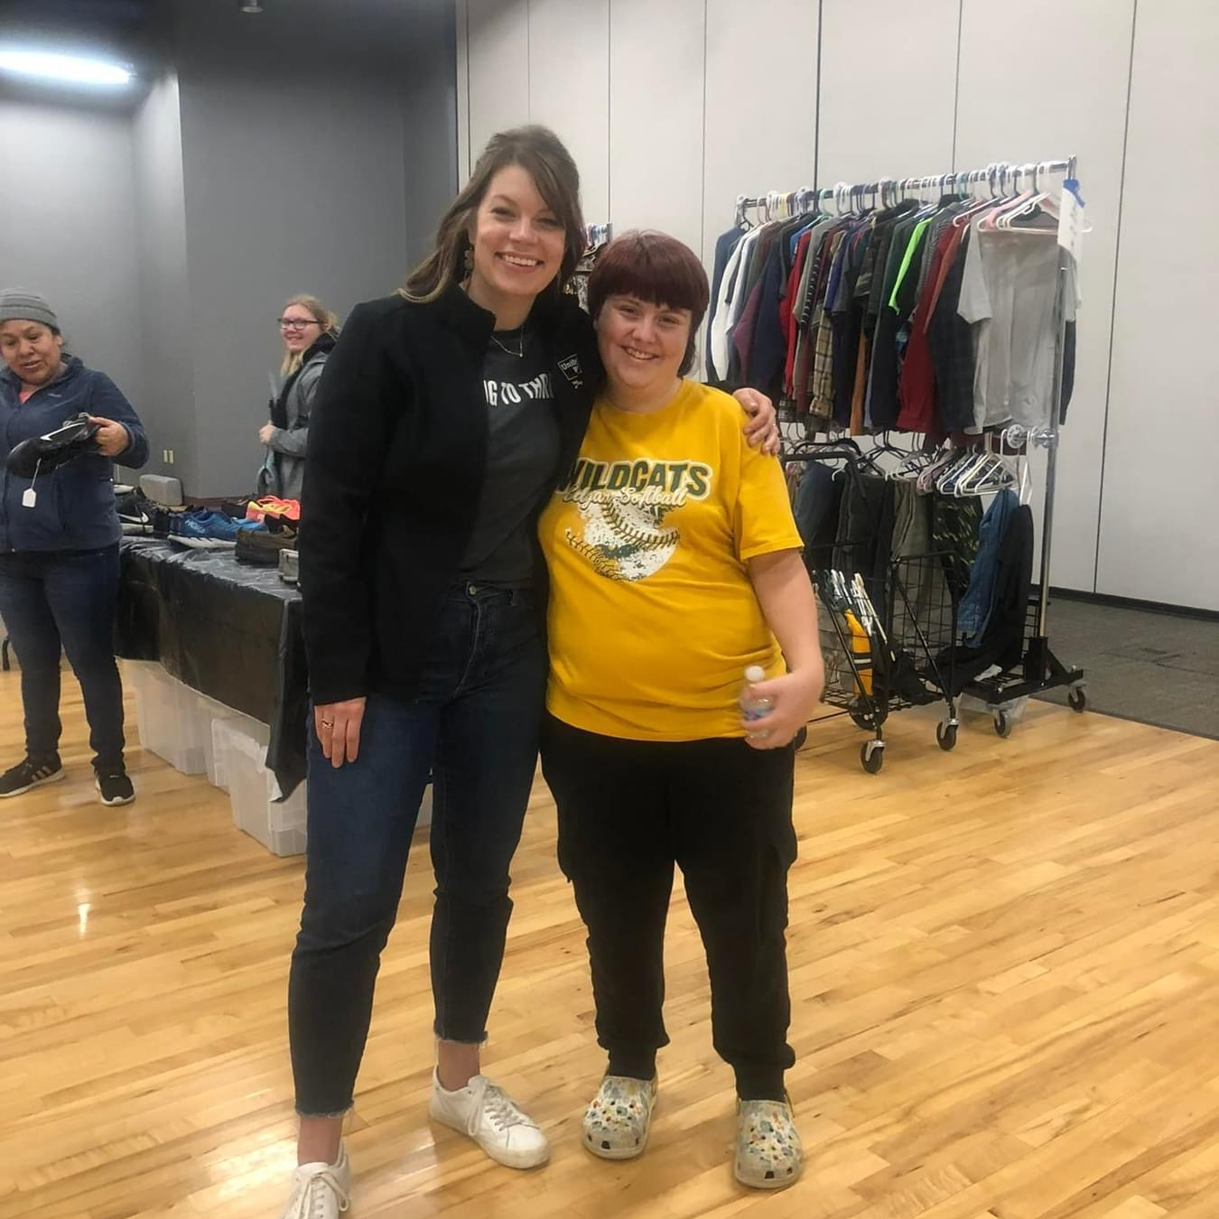
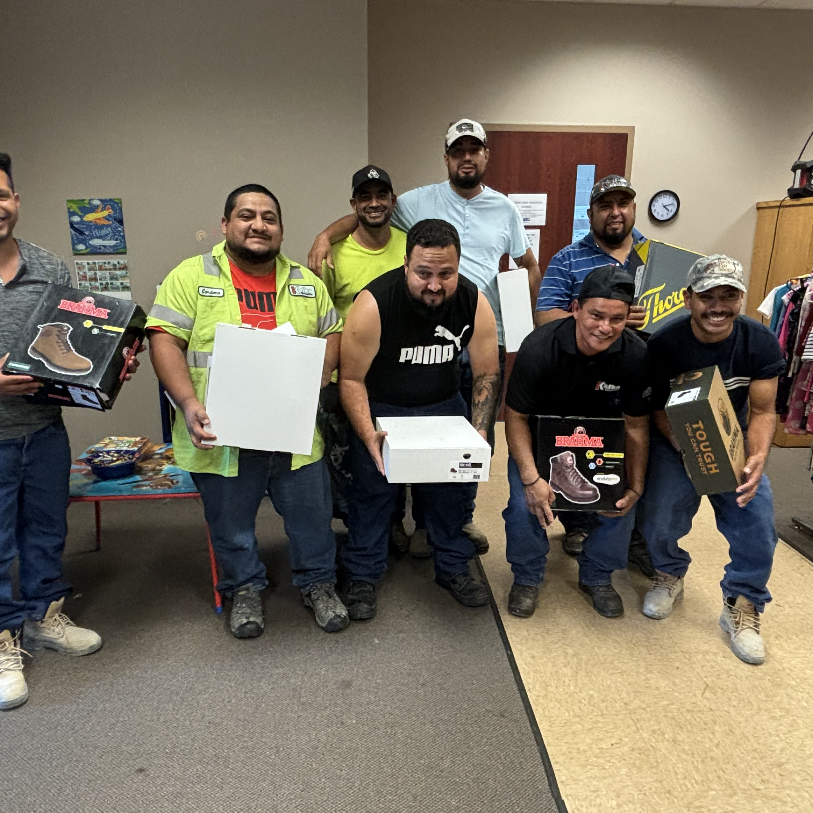
Community Closets
United Way Community Closet is a volunteer-run, donation-driven project. It is housed in the same building as the United Way office, in space donated by Ghidorzi Companies.
The Mobile Community Closet will allow United Way to bring clothes to families at schools, non-profit organizations, and rural communities. This will remove the transportation barrier and time needed to reach the United Way office.
•The United Way Community Closets have a significant impact, helping individuals and families overcome barriers that stand in the way of their success. For many struggling financially, a little help with clothing can make a big difference. The entire family can receive clothing at no cost!
DONATION INTAKE HOURS
Wednesdays: 1 pm – 4 pm
Fridays: 9 am – 12 pm

Slide 10
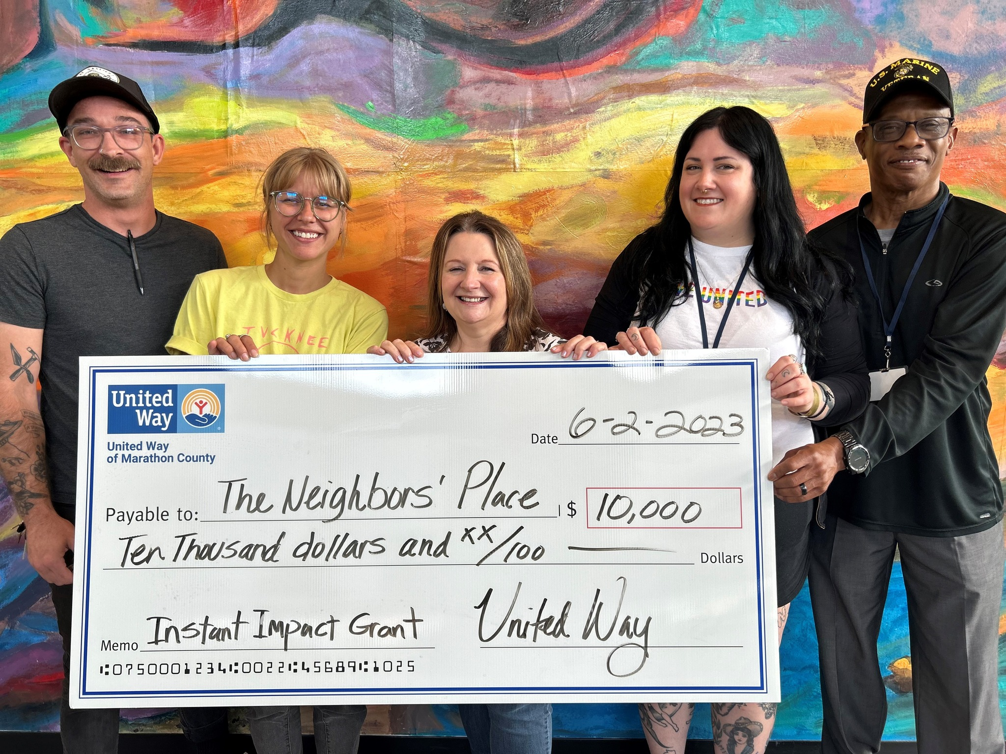
Instant Impact Grants
Warm blankets for elementary school kids, healthy meals, childcare, and rent assistance were just some of the basic needs funded by our Instant Impact grants in 2023. This specific grant opportunity addresses immediate needs or projects in our community that help us achieve our Bold Goal to lift 10,000 community members to financial stability.
Grant Elementary - $5,000
New Beginnings for Refugees - $10,000
Childcaring, Inc. - $10,000
The Neighbors' Place - $10,000
North Central Community Action Program -$10,000

Slide 11
Volunteer
First and Third Thursdays at the Community Closet
We offer one-time volunteer opportunities on the First and Third Thursdays of each month from 2-4pm. You will spend an afternoon with a small team helping sort clothing donations, arrange the shopping floor, do some light cleaning, and help with special projects that make the Community Closet a better resource for Marathon County families!
Farm to Family Produce Program Box Packing
Each week of the growing season, the Hunger Coalition purchases produce from Red Door Family Farm and Cattail Organics, both based out of Athens, WI. This produce gets boxed and distributed to agencies in Marathon County. Your team will help pack the fresh, organic produce into 200 boxes that can more easily be distributed.
This opportunity occurs on Tuesday mornings from 10 a.m. to noon and is a good fit for groups of 3-5.

Slide 12
Volunteer at your Workplace
Clothing Drives: Help us collect the clothing we need to fill the Community Closet! We will provide you with a list of the most needed clothing items, you will set up a collection bin at your workplace and then sort the items by size before bringing them to the Community Closet where guests can get exactly what they need! Contact Director of Community Engagement Carly Hanney for specific needs before getting started. Call (715) 298-5719 or email channey@unitedwaymc.org.
Kit Building: We can help relieve a financial burden from households across Marathon County by providing for people’s basic needs – including adult and children’s hygiene items, snack packs, winter care kits, welcome home kits, and calm kits. We offer different levels of support based on your needs and make it easy for you to make a big impact.

Slide 13
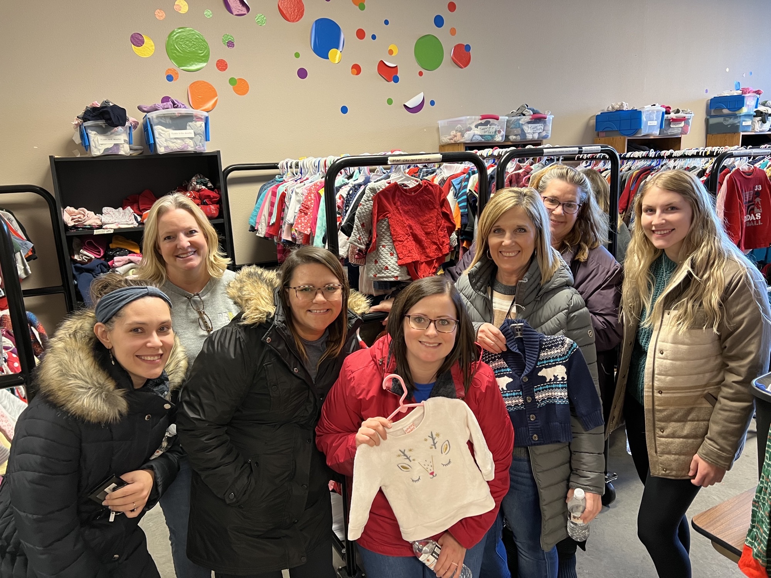
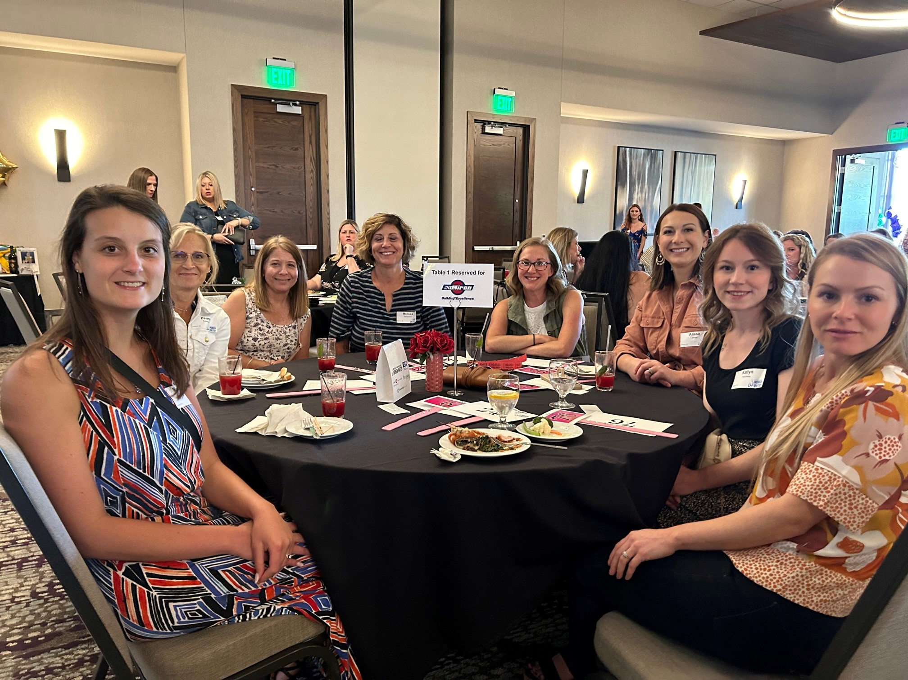
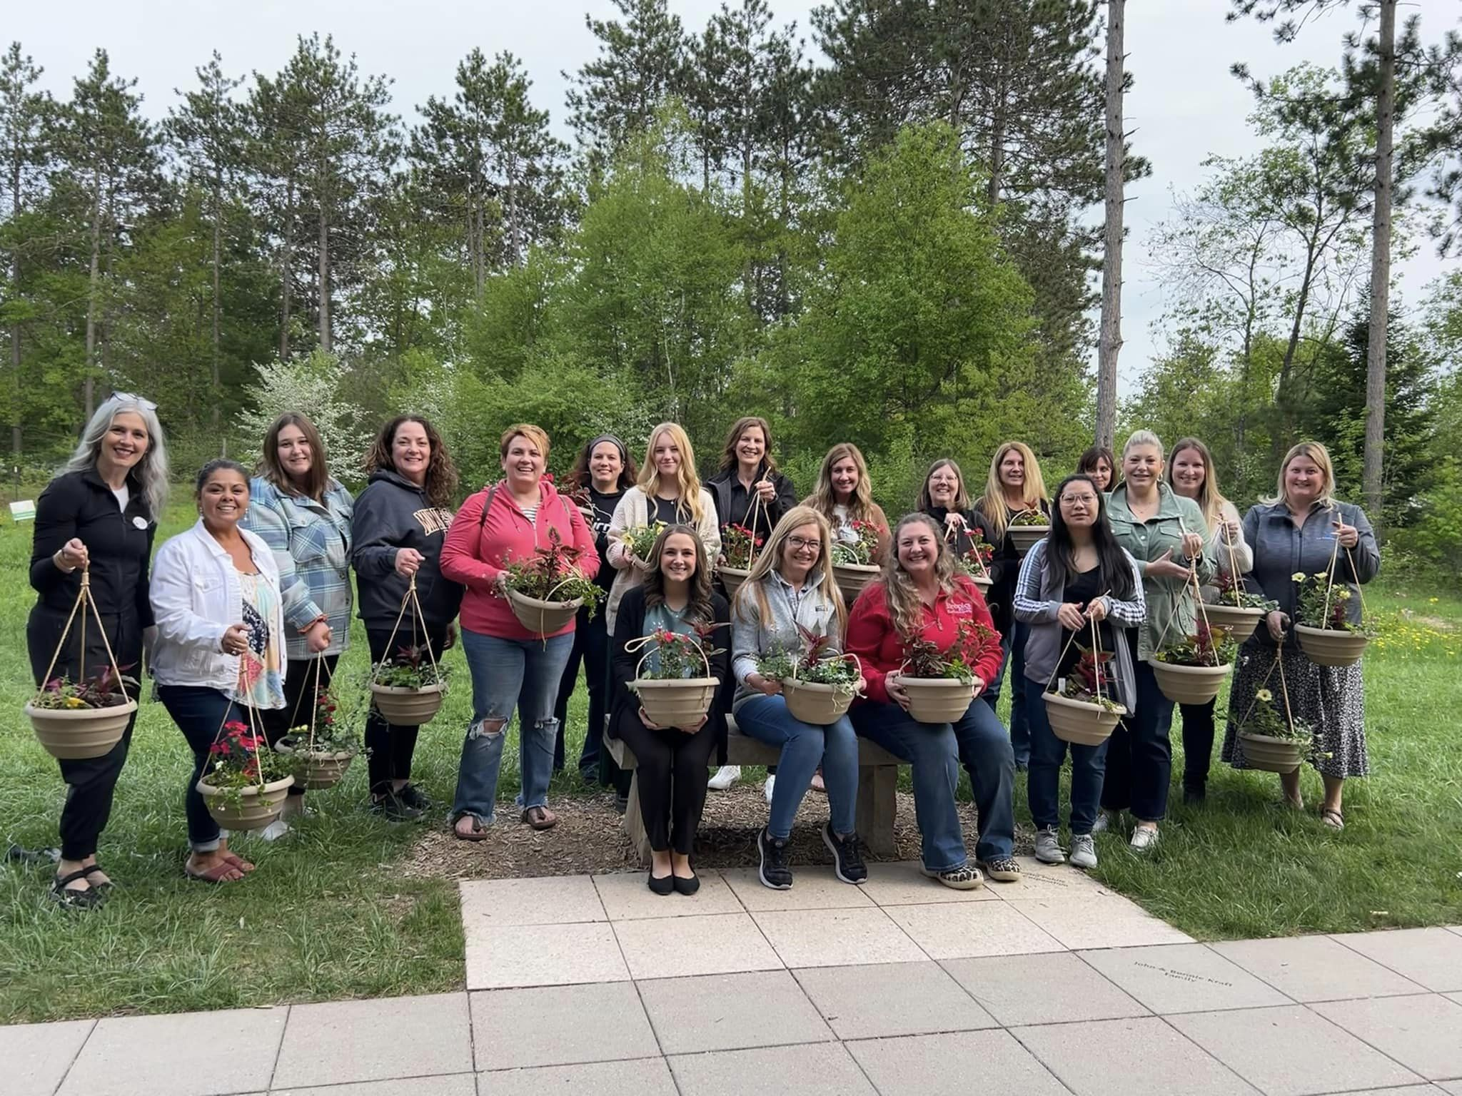
Women United provides members with the opportunity to be part of a dynamic, philanthropic, and fun organization of women leaders who care about our community. It is free to join!
You can attend events, volunteer for projects, join a committee, or graciously contribute financially to support projects.

Slide 14
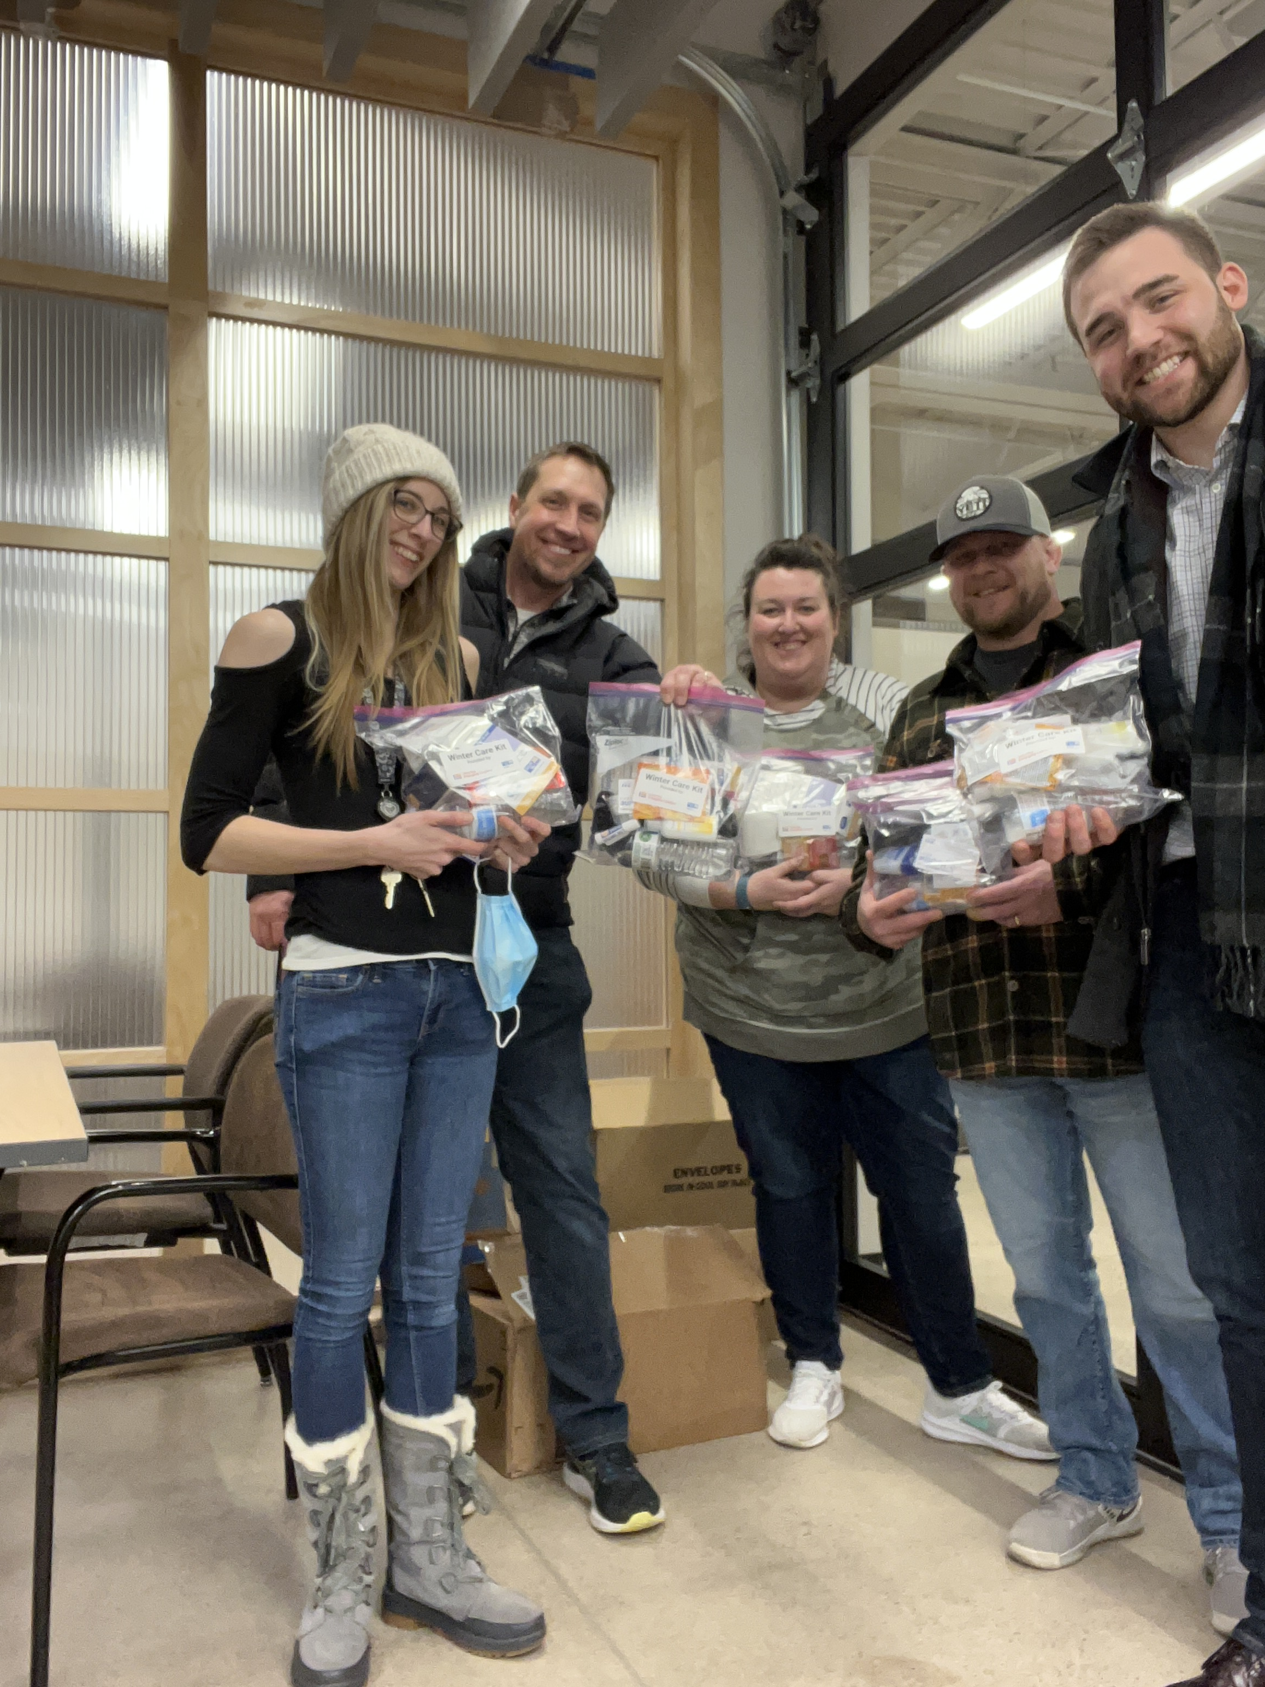
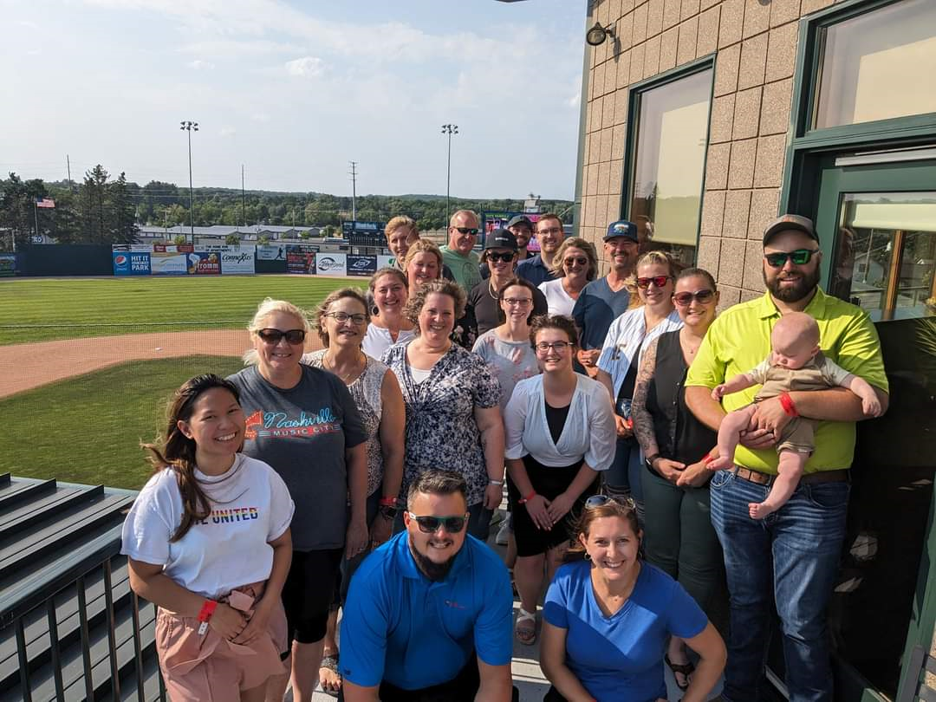
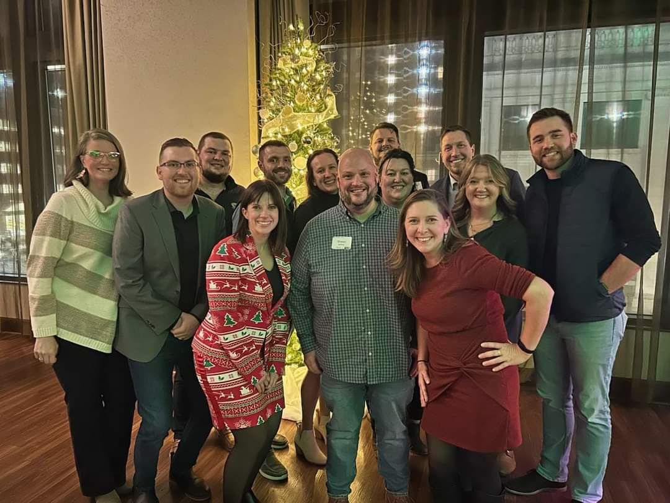
United Way Emerging Leaders is the next generation of professionals who want to make a difference in our community.
Our members enjoy exclusive opportunities to network with business leaders, volunteer for projects, and improve the community we serve. It is free to join!

Slide 15
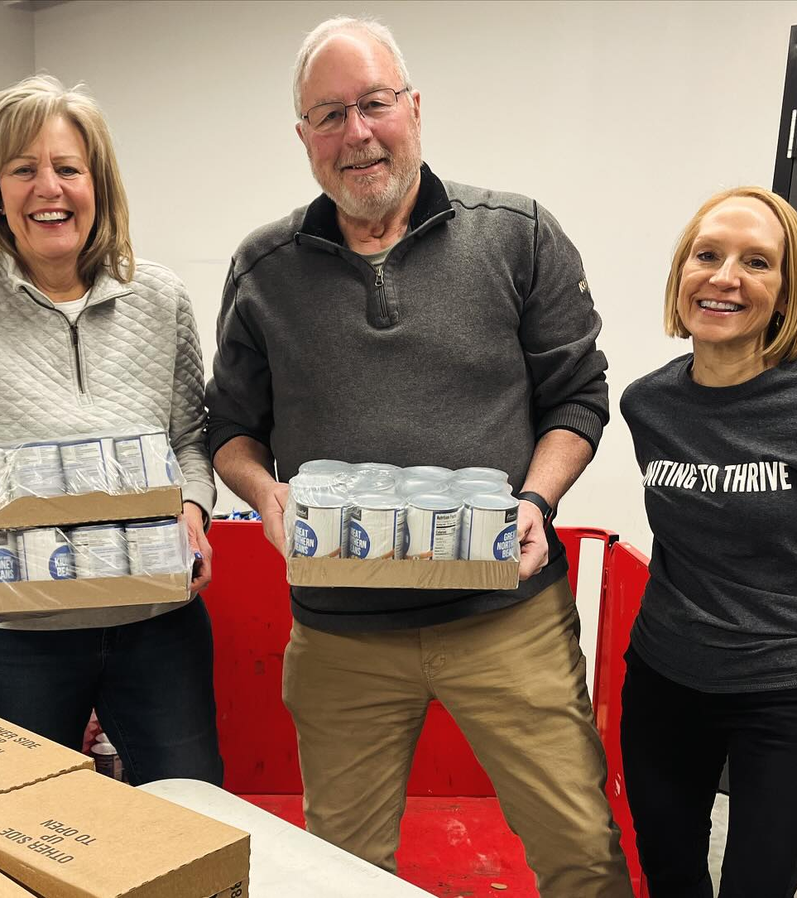
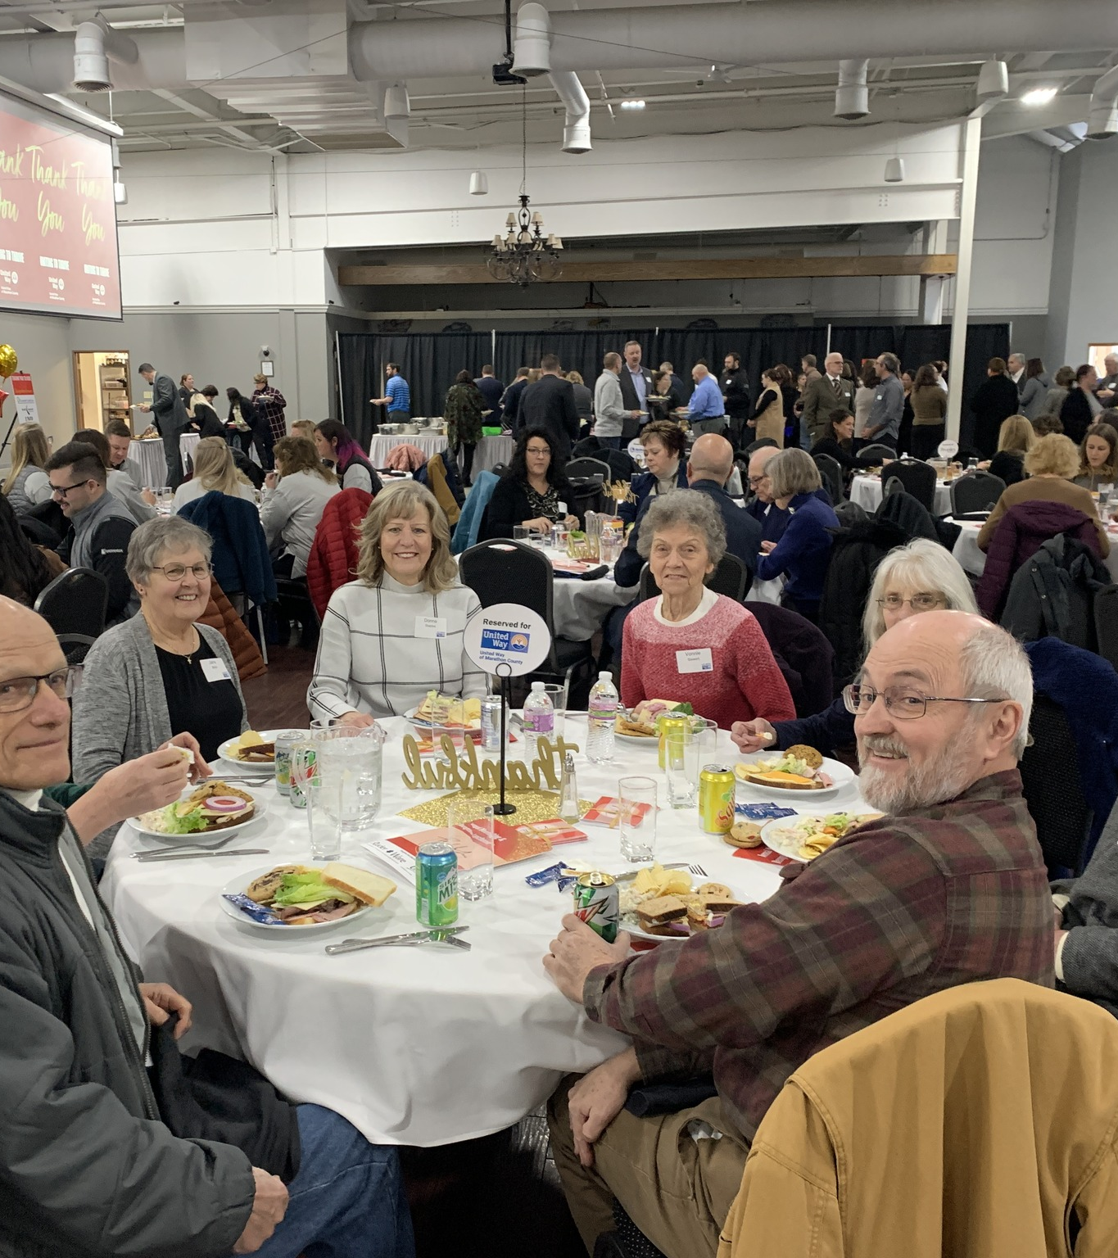
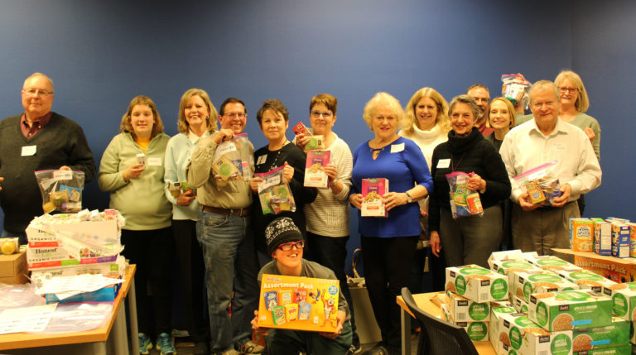
Retire United
United Way Retire United program is designed for individuals who are retired or nearing retirement and recognize the importance that philanthropy and volunteerism play in building a stronger community.
Your lifetime of skills and experiences can benefit future generations. We can help you find a meaningful way to stay engaged in the community.

Slide 16
THANK YOU!
For more information visit: www.unitedwaymc.org
Contact:
Amanda Flannery
Director of Resource Development
715-298-5706
aflannery@unitedwaymc.org
www.unitedwaymc.org

